Slide 1



Arduino Line Follower Car with L298N Motor Driver
A Robotics Innovation Project

Slide 2

Components
What is it?: A line-following robot that uses sensors to detect and follow a path.
Purpose:
Automate movement for tasks like transportation or logistics in robotics.
Objective: Showcase an affordable and functional robotics solution using Arduino.

Slide 3
Components
Circuit Diagram
List of Materials:
Arduino Uno
L298N Motor Driver
4 DC Motors and Wheels
IR Sensors (2)
Chassis
12V Battery Pack
Jumper Wires

Slide 4
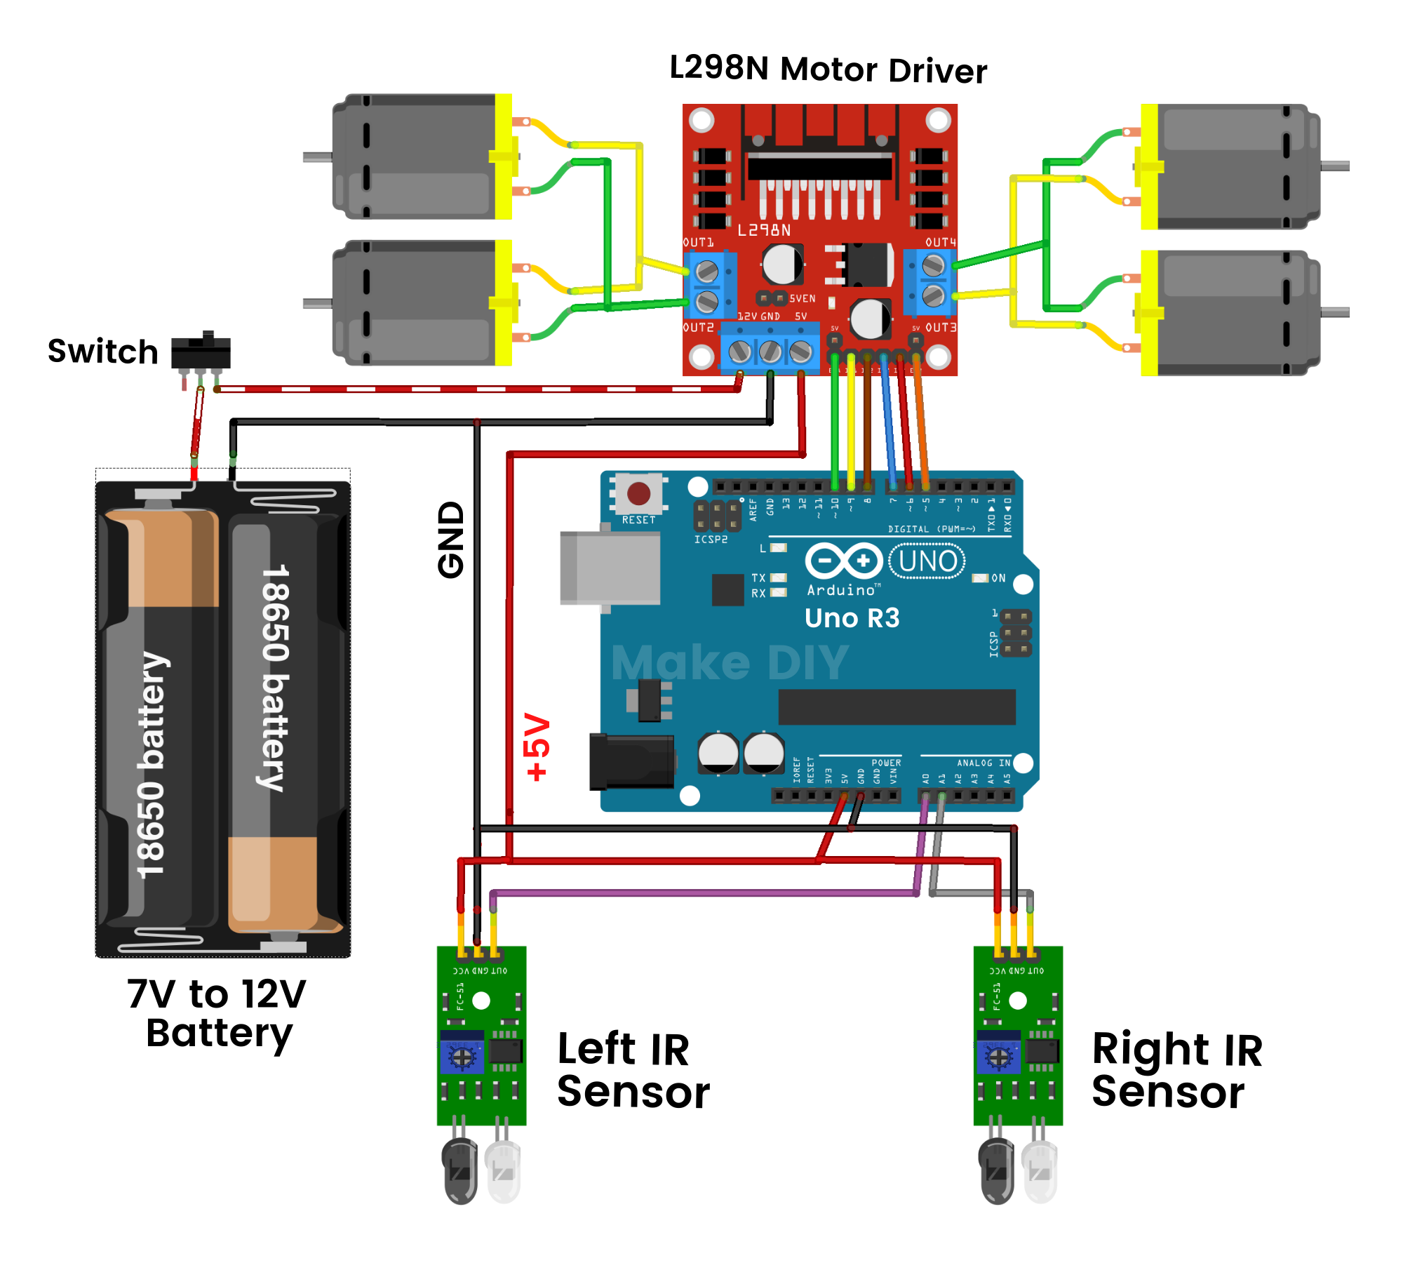
Components
Working Mechanism
Circuit Diagram
Diagram & connentions:
Arduino connected to L298N motor driver.
L298N connected to motors and sensors.
Highlight important pins: ENA/ENB, IN1-IN4, and sensor outputs.

Slide 5
Challenges & Results
Circuit Diagram
Working Mechanism
Working Mechanism
IR sensors detect the black line.
Arduino processes the sensor data.
Motor driver controls motor speed and direction.
Car adjusts itself to stay on the line.

Slide 6
Working Mechanism
Challenges & Results
Challenges
Calibration of sensors on different surfaces.
Balancing motor speeds for smooth movement.
Power management with the battery pack.
Outcomes:
Successfully followed the line
Smooth turns on curves.Maintained
stability on straight paths.

Slide 7
Thank You "Thank you for your attention!"
Challenges & Results

Slide 8
Names:

